Slide 1






AI Psychologist: An Empathetic Mental-Health Chatbot with Long-Term Memory
汇报人：Kimi AI
时间：2025/08/05

Slide 2







CONTENTS
目录
1
Vision & Value
2
Core Features
3
Technical Blueprint
4
Plan & Risk
5
Budget & Metrics
6
Future Horizons

Slide 3



01
SECTIONS
Vision & Value

Slide 4


AI Psychologist: 24/7 Empathetic Mental Support
Core Product Vision
01
Target Audience
02
Learning Opportunity
03
Introducing an AI-driven mental health chatbot that offers continuous, empathetic support, remembering user history and preferences to provide personalized care.
Primarily aimed at students, addressing the scarcity of professional psychological resources and high costs, while ensuring privacy and accessibility.
A hands-on project to gain practical experience in AI application development, focusing on real-world implementation and user feedback.

Slide 5

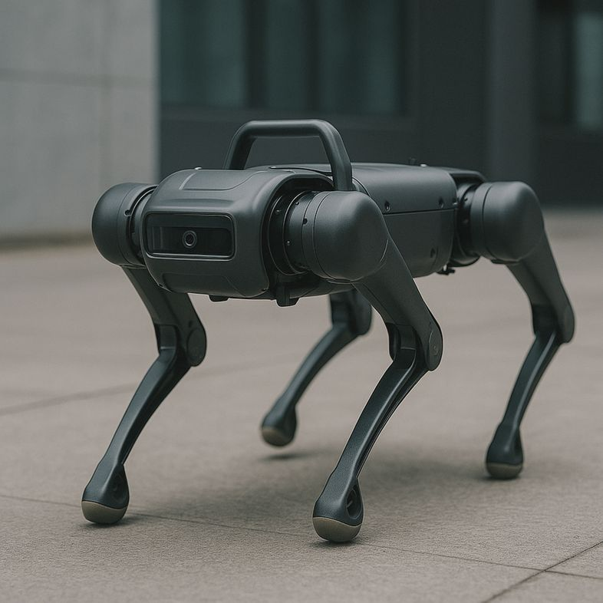
Pain Points & Objective Tree
Identified Pain Points
Long wait times, high costs, and privacy concerns in traditional psychological consultations are major barriers for students seeking mental health support.
Project Objectives
To develop an AI psychologist with professional knowledge, implement a multi-layer memory system, ensure local data storage for privacy, and explore low-cost deployment strategies.

Slide 6
02
SECTIONS
Core Features

Slide 7

Long-Term Memory Stack: Never Forget a User
01.
02.
Working Memory
Episodic Memory
Maintains short-term context for seamless conversation flow, ensuring the bot understands immediate dialogue cues.
Records user interactions with timestamps, allowing the bot to track events and mood changes over time.
03.
04.
Semantic Memory
Procedural Memory
Stores stable user traits and preferences, enabling the bot to provide consistent and personalized responses.
Holds counselling skills and techniques, ensuring the bot can apply learned strategies to support users effectively.

Slide 8




Knowledge Engine & Personalized Empathy
Integrated Knowledge Engine
The AI psychologist integrates an evidence-based intervention library, dynamic learning from successful chats, and configurable personas to offer culturally sensitive, empathetic support.

Slide 9
03
SECTIONS
Technical Blueprint

Slide 10


Lightweight Local Tech Stack
Cost-Effective Architecture
Local Data Storage
Utilizes Python, OpenRouter free-tier endpoints, ChromaDB or FAISS for vector storage, FastAPI for backend services, and an initial CLI interface.
Ensures user data remains local, with encrypted backups for security, eliminating cloud costs and enabling offline usage.

Slide 11







Modular System Architecture
Handles vector CRUD operations and semantic retrieval, ensuring efficient memory management.
Memory Manager
Crafts prompts enriched by user history, enabling coherent and context-aware conversations.
Hosts therapy guidelines and intervention strategies, providing a robust knowledge base for the AI psychologist.
Dialogue Generator
Knowledge Service

Slide 12
04
SECTIONS
Plan & Risk

Slide 13


Three-Stage Iterative Roadmap
Iterative Development Plan
A 12-week timeline split into three four-week sprints, delivering incremental improvements and ensuring continuous validation.

Slide 14




Risk Register & Mitigation
Key Risks
Mitigation Strategies
Free-tier quota exhaustion, memory bloat, and accidental data deletion are identified as primary risks.
Maintain secondary model endpoints, implement forgetting algorithms, and schedule encrypted backups to mitigate identified risks.

Slide 15
05
SECTIONS
Budget & Metrics

Slide 16
Zero-Budget Kick-off & Low-Cost Scaling
Optional costs include domain names and paid API tiers, keeping expenses minimal even at scale.
Future Costs
01
Initial Cost
The project leverages free resources such as OpenRouter, open-source libraries, and local hardware to start with zero budget.
01

Slide 17



KPIs for Technical & UX Success
Technical KPIs
Response latency below ten seconds, memory layer 100% uptime, and system availability 99% monthly.
1
User Experience Metrics
User satisfaction ≥85%, continuity perception rated at least four out of five, and increased conversation turns.
2
Data-Driven Iteration
KPIs are logged and visualized on a dashboard for continuous improvement and validation.
3

Slide 18
06
SECTIONS
Future Horizons

Slide 19



Towards Multimodal & Research Ecosystem
Growth Path
Research Collaboration
Short-term addition of voice interaction and mobile apps, medium-term multilingual support, and long-term integration with wearable devices.
Open benchmarks for memory-forgetting algorithms and therapy-outcome analytics to invite collaboration with academic labs.

Slide 20

THANKS
感谢观看
汇报人：Kimi AI
汇报时间：2025/08/05

